Slide 1

Robot Obstacle avoidance with reinforcement learning
Group Members:
Alexandre Dietrich
Ankur Tyagi
Haitham Alamri
Rodolfo Vasconcelos
Intelligent Systems and Reinforcement Learning

Slide 2
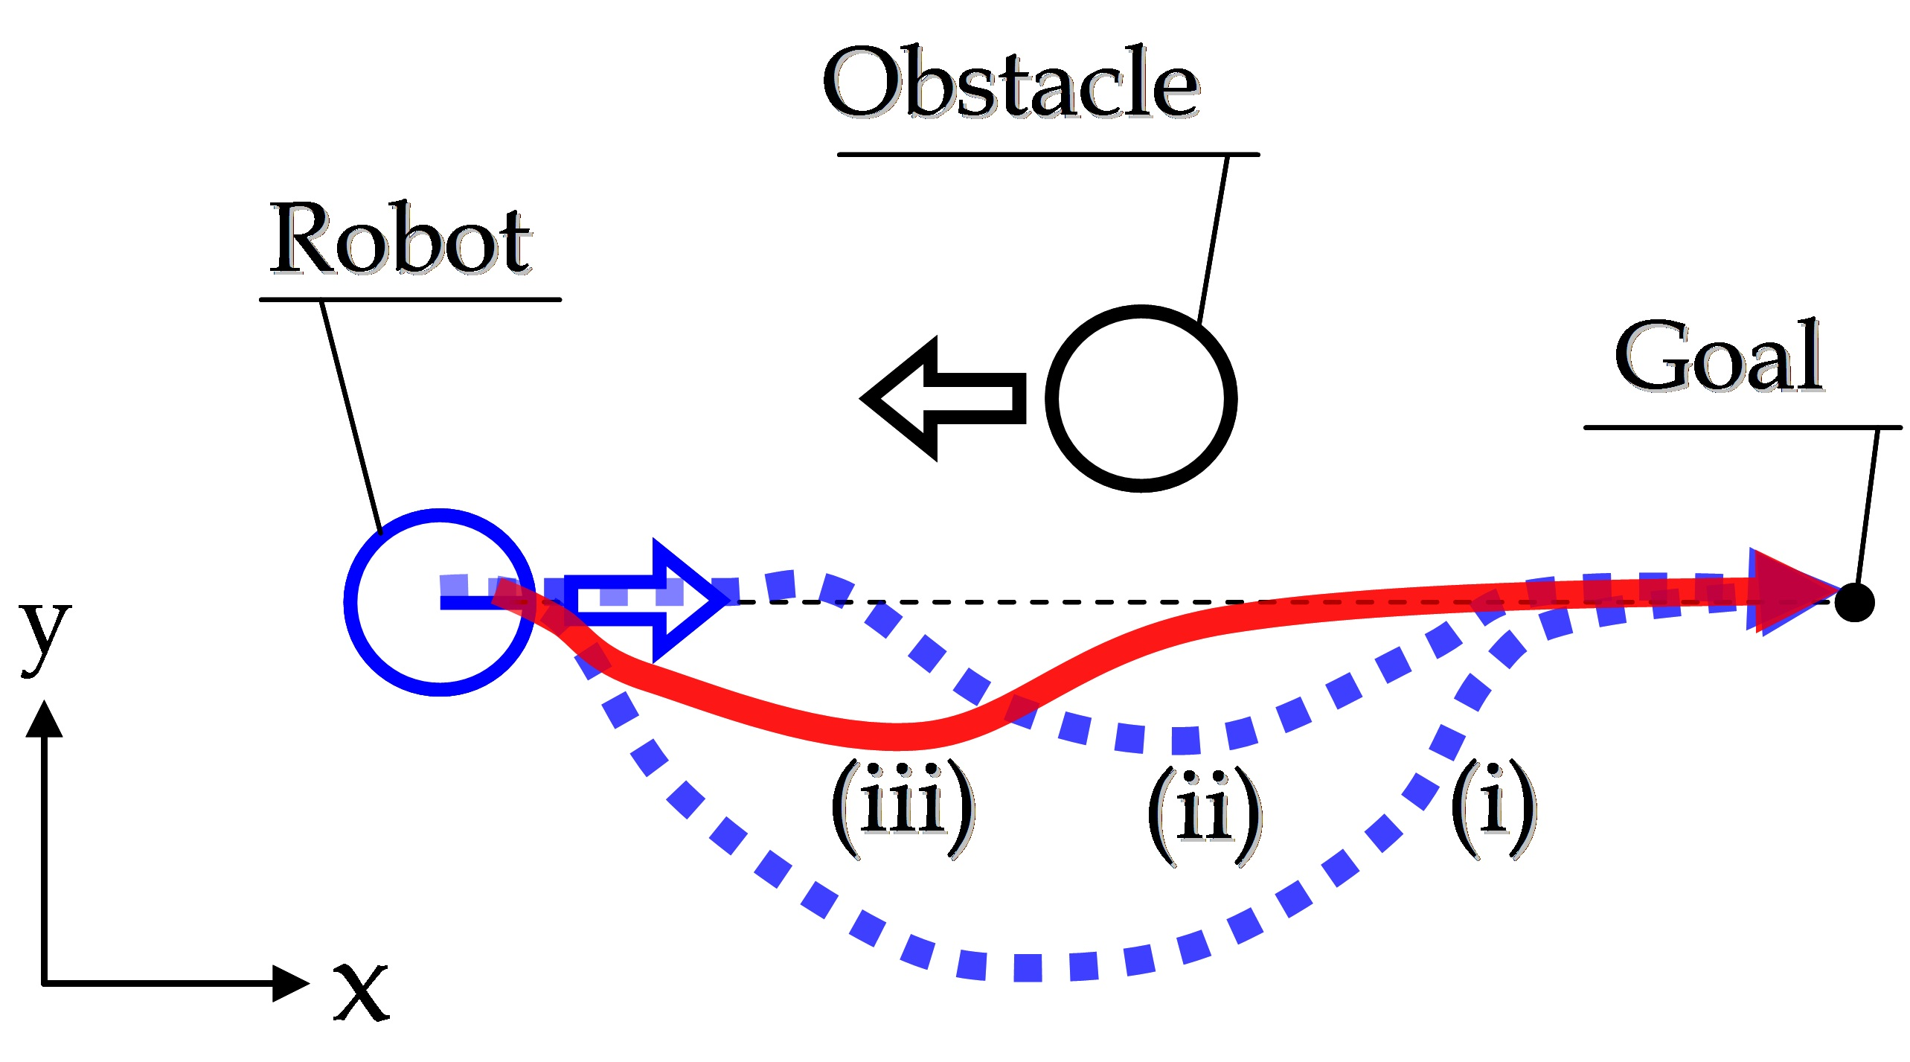
Problem Statement
Find the path for robot to reach an end point (goal state) while avoiding randomly generated obstacles in a 2D space

Slide 3
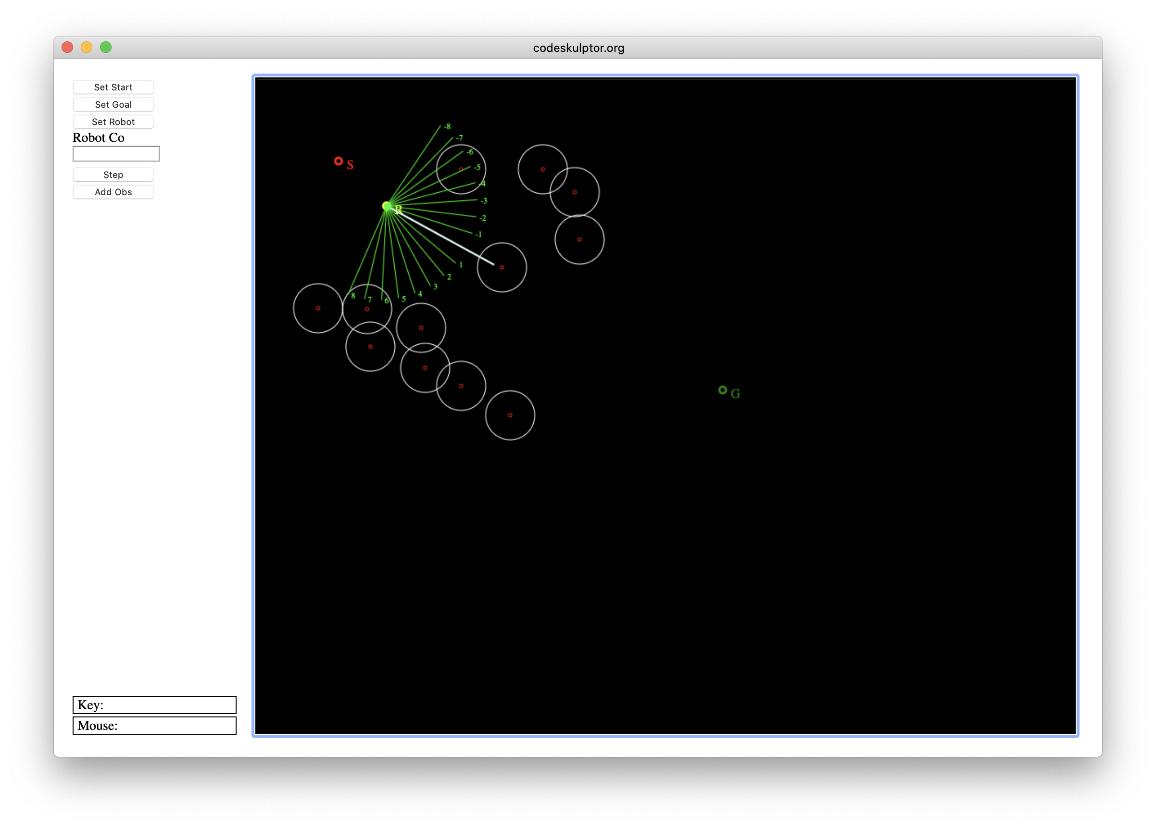
Environment
Environment simulation using python 3 for the project
Simulation Steps:
Choose the starting coordinates of the robot
Choose the target coordinates
Define static obstacles – generated randomly for each episode
Define number of sensors on the robot
Navigate the path using the step and avoid any incoming obstacles while navigating towards the target state.
Objectives:
Identify and optimize the algorithm to avoid the obstacle and reach the destination
Compare the efficiency of algorithms against each other.
*sample screen shot

Slide 4
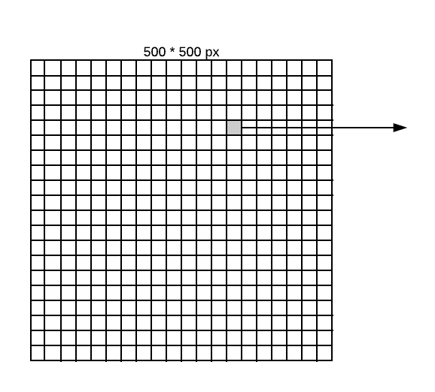
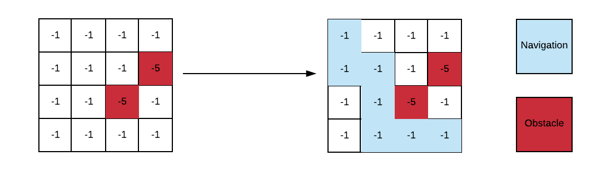
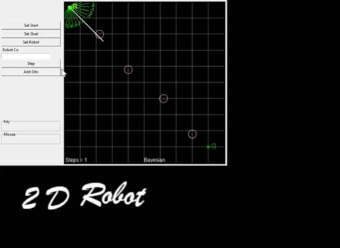
Solution Approach
Set the Canvas size to be 500*500 pixels Grid of 50*50px with each grid of 12.5 pixels Actions(s): Up, Down, Right and left Dynamically generated obstacles | States: all possible states within a 4 x 4 grid with 0 or more obstacles Reward function: -1 cost of step -5 cost of obstacle 0 goal end state
One grid - matrix with 2 possible obstacle

Slide 5
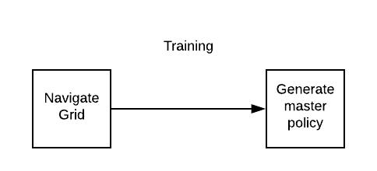
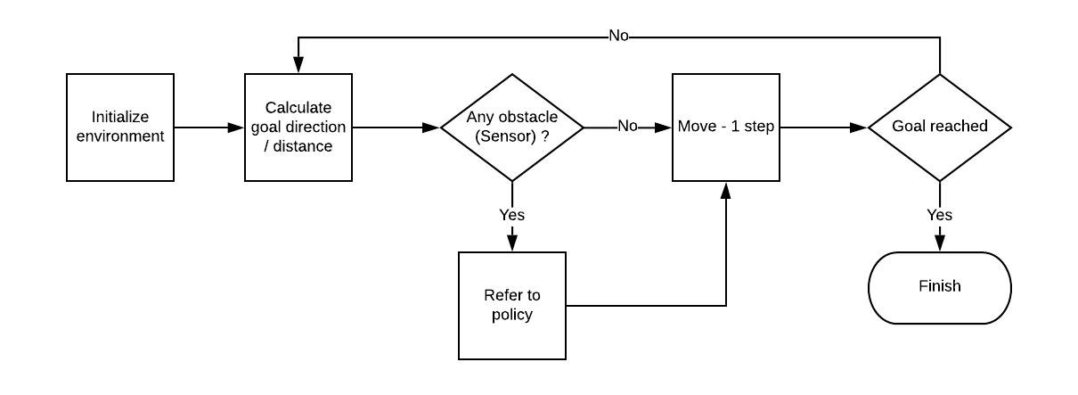
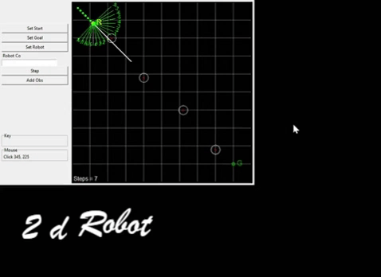
algorithm – 1 (Bayesian + static)
Execution Steps:
Environment: Starting point : top corner(0,0) End point - bottom right corner (500, 500) Monte-carlo method to simulate 1000’s of episodes and value iteration Find optimal q-value for every state in 4*4 grid and determine action based on epsilon soft policy algorithm The generated master policy is a dictionary of states and actions for all 50*50 grids Use the optimal policy to playing stage and then run through the agent from the starting point to the goal T(s'|s; a): probability of reaching s' if action a is taken in state s = 1 (No uncertainty)
Step - Run

Slide 6
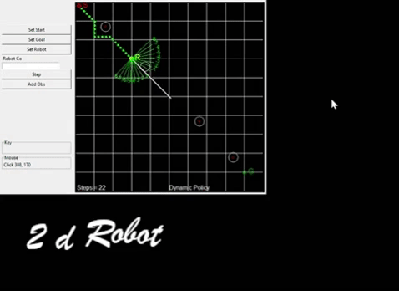
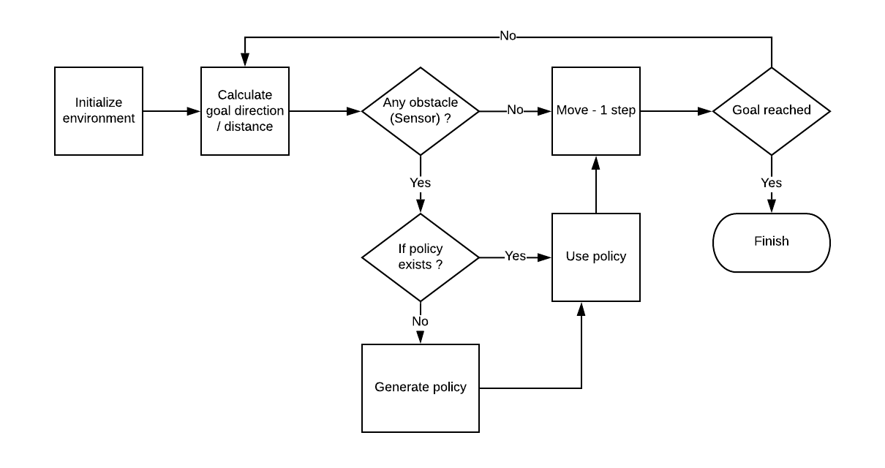
algorithm – 2 (Dynamic Bayesian policy)
Environment Dynamic start point for the robot Dynamic goal (end-point) for the robot In start of every episode robot begins without a policy | If a policy is not available for that state, a new policy is created using the same Monte Carlo method T(s'|s; a): probability of reaching s' if action a is taken in state s < 1 (some uncertainty)

Slide 7
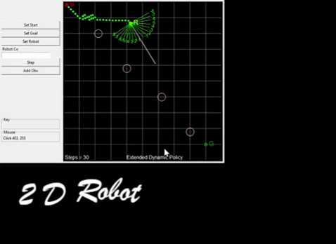
algorithm – 3 (Extended Dynamic Policy)
Environment Dynamic start point for the robot Dynamic goal (end-point) for the robot Algorithm extension : In this algorithm, the policy matrix calculation is changed where the policy looks into nearby square matrix as well to define the path of the robot Grid calculation changed from 50*50 to 250 * 250px Instead of Monte-carlo in a grid of 4*4 , we are calculating a grid of 5*5.

Slide 8
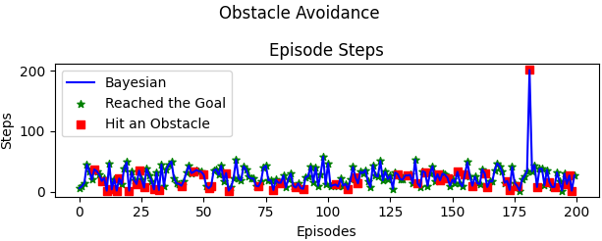
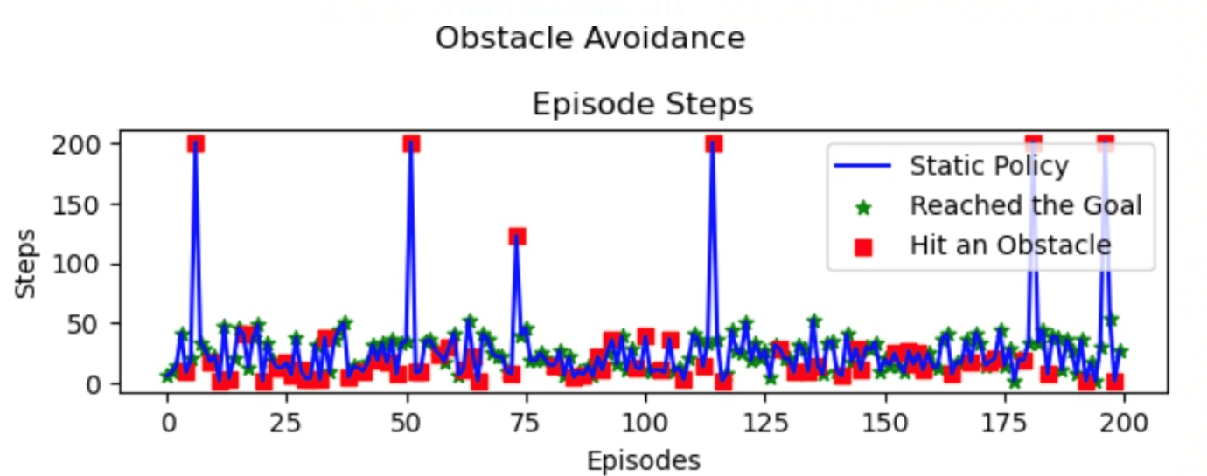
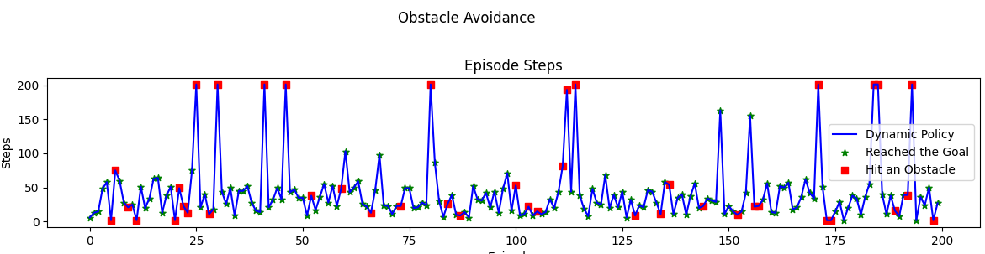
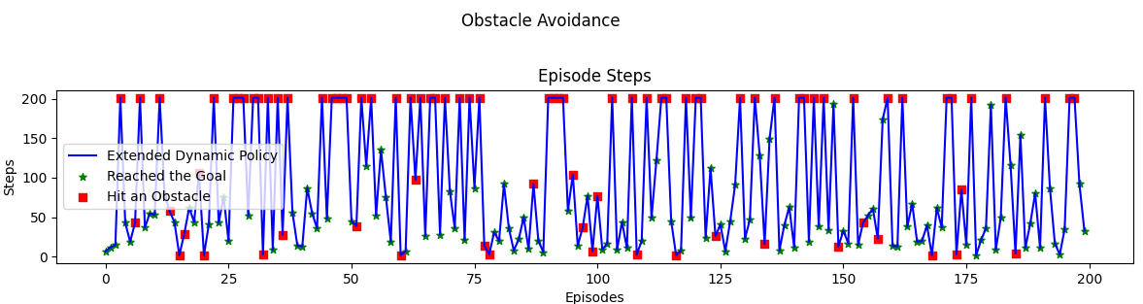
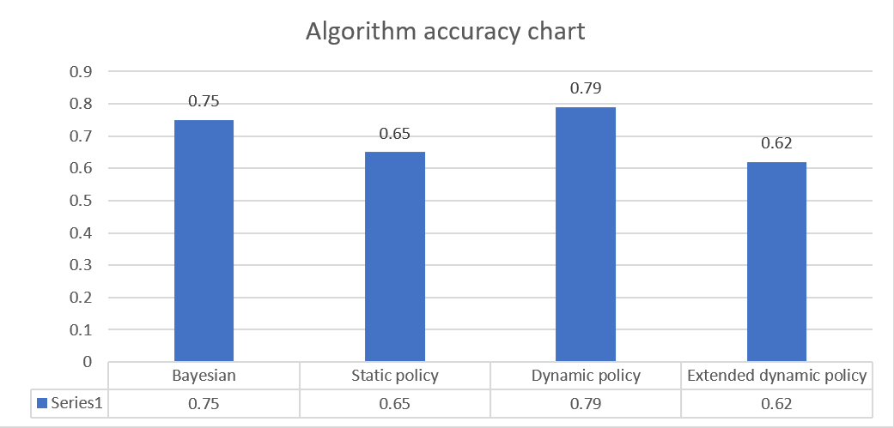
Summary - Algorithm Comparisons
Dynamic policy algorithm has the highest consistency among all the algorithm to navigate through obstacles while extended dynamic policy couldn’t scale up as expected.
Github: https://github.com/ravasconcelos/rl_obstacle_avoidance/
Report: https://github.com/ravasconcelos/rl_obstacle_avoidance/blob/master/notebook/Term%20Project%20V2.ipynb

Slide 9
Conclusion – Lesson Learnt and future work
Lesson Learnt
It’s difficult to solve continuous problems using discrete solutions
Enhancing object detection function has improved object avoidance algorithm
Possible extensions of the work include :
Use deep learning – q network to further increases the accuracy for the path navigation as done in the snake game (reference : https://github.com/maurock/snake-ga)
Use deep deterministic policy gradient for solving the problem in continuous domain (reference : https://www.youtube.com/watch?v=PngA5YLFuvU&t=187s)

